Slide 1



Advanced Network Security
Assessment & Forensics
A hands-on practical investigation of network discovery, deep packet inspection, TCP flag correlation, vulnerability assessment, and defense-in-depth hardening.
Intern Role Cybersecurity Intern
Evaluation Scope Authorized Virtual Lab (192.168.56.0/24)
Core Tooling Nmap 7.94 • Wireshark 4.2 • UFW
Submission Deadline 21st September 2026

Slide 2


Assessment Objectives & Scope
Operational Objectives
Scope & Compliance
▹
Conduct host discovery & service mapping across the 192.168.56.0/24 subnet.
▹
Strict adherence to ethical guidelines: isolated VirtualBox Host-Only sandbox (vboxnet0).
▹
Execute TCP SYN stealth scanning, UDP surface scans, and NSE vulnerability audits.
▹
Zero packet leakage into corporate uplinks, physical gateways, or external ranges.
▹
Perform deep-packet inspection using Wireshark across Layer 2-7 core protocols.
▹
Systematic vulnerability documentation mapped to CVSS v3.1 and MITRE ATT&CK.
▹
Correlate Nmap scanner state decisions directly with raw wire TCP flags.
▹
Execution of stateful host firewall hardening with quantifiable attack surface reduction.

Slide 3

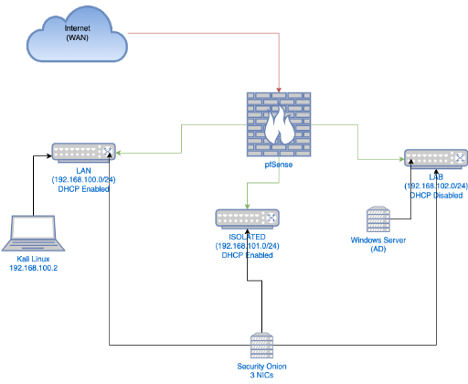




Authorized Lab Architecture
Node 1: Kali Linux 2026
Security Auditor Console • Tools: Nmap 7.94, Wireshark 4.2.3, Scapy • MAC: 08:00:27:A4:81:12
Node 2: Ubuntu Server 24.04
Enterprise Target Node • Initial Services: FTP (21), SSH (22), Apache (80), RPC (111), SMB (445)
Node 3: Windows / Metasploit
Legacy Workstation • Services: SMBv1/v2, NetBIOS, RDP • MAC: 08:00:27:F9:11:4E
Virtual Gateway / Switch
VirtualBox Host Adapter Bridge • Isolated Broadcast Domain • Mask: 255.255.255.0

Slide 4






Auditing Software Ecosystem
Nmap 7.94SVN
Wireshark 4.2.3
UFW & Defense Tools
Raw packet generator and port auditing engine. Leveraged for ARP ping sweeps (-sn), TCP SYN half-open probing (-sS), service banner discovery (-sV), and NSE vulnerability scripts.
High-fidelity protocol analyzer utilizing Npcap/libpcap drivers. Applied with promiscuous capture to dissect ARP, ICMP, DNS, TCP handshakes, and application layer HTTP payloads.
Ubuntu Uncomplicated Firewall configured for default-deny inbound filtering. Combined with OpenSSH 9.6p1 cryptographic hardening and service daemon decommissioning.

Slide 5
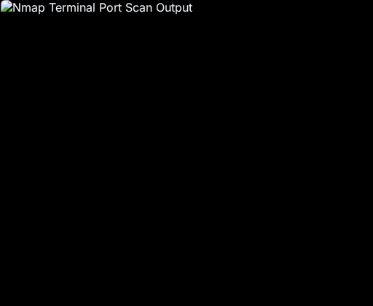


Nmap Reconnaissance & Audit
FTP & RPC Daemons
vsftpd 3.0.5 running cleartext auth with anonymous upload. RPCbind v2-4 leaking internal program mappings.
Web & Remote Admin
Apache 2.4.58 running over unencrypted HTTP. OpenSSH 9.6p1 permitting root interactive password logins.
SMB & NetBIOS Services
Samba smbd 4.19.5 accessible across subnet; permits unauthenticated NULL/Guest sessions and RID cycling.
Operating System Fingerprint
TCP/IP stack analysis confirmed standard Linux kernel; latency 0.0017s across the VirtualBox virtual adapter.

Slide 6
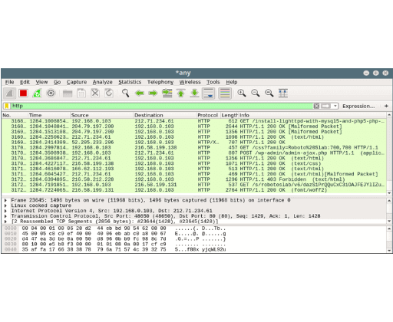
Wireshark Packet Dissection
ARP Broadcasts (#104-105)
Broadcast resolution to ff:ff:ff:ff:ff:ff ("Who has 192.168.56.102?"). Reveals unauthenticated L2 mapping vulnerable to ARP poisoning.
TCP 3-Way Handshake (#452-454)
RFC 793 handshake: [SYN] (ISN=0) → [SYN, ACK] → [ACK]. Validates successful transmission channel before application payload transfer.
Cleartext HTTP GET (#455)
Unencrypted layer-7 HTTP transmission exposing User-Agent headers, URI parameters, and sensitive session tokens in plaintext.
DNS Queries & ICMP Echo (#218-340)
Standard UDP 53 resolution and ICMP Echo ping verification (Type 8/0) confirming host responsiveness.

Slide 7
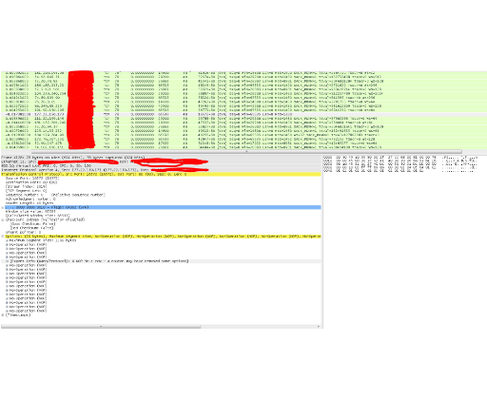

Scanner Packet Correlation
Open Port 80: SYN → SYN/ACK → RST
Server returns [SYN, ACK] (0x012). Nmap immediately transmits [RST] (0x004) to terminate connection before OS logging.
Closed Port 9999: SYN → RST/ACK
Host kernel receives probe for inactive socket; immediately returns [RST, ACK] (0x014) actively rejecting the socket.
Filtered Port 8080: SYN → Retransmit / Drop
Stateful firewall (UFW/iptables) silently drops probe. Scanner receives no response and classifies port as Filtered.
Wireshark Filter Logic
Isolates half-open scans on wire: rapid burst of high-frequency SYN packets across ports followed by immediate RST resets.

Slide 8
Vulnerability Registry & CVSS
ID | Finding & Protocol | Risk Tier | CVSS v3.1 | Exploitation Vector | Remediation Mandate
V-01 | Anonymous FTP Enabled | High | 7.5 | Cleartext credential sniffing & unauthenticated file staging. | Decommission vsftpd; migrate file transfers to SFTP (Port 22).
V-02 | Root SSH Password Login | High | 7.4 | Automated brute-force attacks and credential spraying. | Enforce Ed25519 key authentication; set PermitRootLogin no.
V-03 | Permissive Samba Null Session | High | 7.1 | Anonymous IPC$ binding, RID cycling, and user enumeration. | Enforce SMB signing; restrict NetBIOS/SMB to local management.
V-04 | Unencrypted HTTP & Banner Leak | Medium | 5.3 | MitM session eavesdropping; OS/Apache banner scraping. | Deploy TLS 1.3 certificates; set ServerTokens Prod.
V-05 | Exposed Legacy RPC Portmap | Medium | 5.0 | NFS program disclosure, buffer overflow amplification. | Disable rpcbind.service and rpcbind.socket via systemctl.

Slide 9
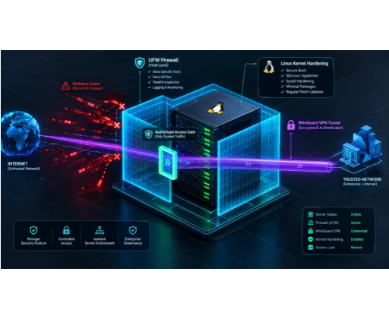
Hardening: Before vs. After
Port 21 (FTP): Open → Filtered
vsftpd daemon disabled and masked; inbound port blocked in UFW. Cleartext interception vector eliminated.
Port 111 (RPC): Open → Filtered
Purged rpcbind service and listening sockets. Memory dump and internal RPC program mapping disabled.
Port 22 (SSH): Root Auth → Whitelisted
Root password login revoked; enforced Ed25519 public key auth with UFW rule whitelisting only the analyst IP.
Firewall: Disabled → Default DROP
UFW default policy set to DROP. 65,533 ports converted to filtered non-responsive states, denying reconnaissance.

Slide 10





Attack Surface Reduction
66.7%
65,533
Quantified Defensive Gains
Reduction in Exposed Services
Ports Converted to Filtered Drop
By shifting from an open default policy to a strict host-based stateful packet filter, the target system ceased responding to indiscriminate probes.
100%
0
Active port enumeration overhead for an adversary increased from 0.24 seconds to sustained scan timeouts, significantly raising the cost of reconnaissance.
Cleartext Protocols Decommissioned
Anonymous Logins Permitted

Slide 11
Strategic Recommendations
Enforce Universal Transport Encryption: Mandate TLS 1.3 across all HTTP endpoints and substitute legacy cleartext transfer daemons (FTP, Telnet) exclusively with SFTP/SSH.
Stateful Default-Deny Firewalling: Standardize UFW/iptables baselines across all operating systems. Whitelist management ports (SSH/RDP) strictly to verified administrative subnets.
Zero-Password Administrative Access: Revoke interactive root password login; implement Ed25519 hardware-backed key pairs and deploy Fail2ban for brute-force rate limiting.
Disable Legacy Broadcast Daemons: Turn off LLMNR, NetBIOS over TCP/IP, and Avahi mDNS to eliminate lateral credential poisoning and Responder relay attacks.
Continuous Telemetry & IDS Monitoring: Deploy automated network sensors (Suricata/Zeek) with rulesets designed to flag SYN half-open bursts and DNS tunneling.

Slide 12



Assessment Sign-off & Q&A
Practical assessment completed in full compliance with legal and ethical lab guidelines. All technical artifacts, scripts, and PCAP captures cataloged.

Slide 13





Image Sources
https://miro.medium.com/1*CCsLTPf1mIlRuGhVMbBXvQ.png
Source: medium.com
https://linuxblog.io/wp-content/uploads/2026/05/nmap-scan-terminal.jpg
Source: linuxblog.io
https://www.tecmint.com/wp-content/uploads/2012/08/Wireshark-Analyze-Network-Traffic-in-Linux.png
Source: www.tecmint.com
https://osqa-ask.wireshark.org/upfiles/tcp_40bytes.PNG
Source: osqa-ask.wireshark.org
https://aisecuritywatch.com/wp-content/uploads/2026/09/linux-ufw-firewall-wireguard-hardening-architecture-1024x576.webp
Source: aisecuritywatch.com

